Slide 1
The Effect of Weather on S&P 500 Market Performance
Yelizaveta Nazarova
Eco 590
Professor Kaltenberg

Slide 2
Motivation
Financial markets are often assumed to be fully rational, but investor behavior can be influenced by psychological and environmental factors.
Previous behavioral finance research suggests that weather conditions may affect mood, risk tolerance, and trading decisions.
This project explores whether daily weather conditions in New York have any relationship with S&P 500 market performance.
Understanding these relationships may provide insights into investor sentiment and market dynamics.
RESEARCH QUESTION
Do weather conditions influence investor behavior in financial markets?

Slide 3
Key Variables
Dependent Variable
S&P 500 Closing Price (close)
Daily market return (daily_return)
Independent Variables
Temperature — daily average temperature
Humidity — daily relative humidity
Cloud Cover — percentage of cloudiness
Wind Speed — daily average wind speed
Calculated variables Variables
Good Weather dummy — equals 1 during comfortable weather conditions and 0 otherwise.
Bad Weather Dummy — equals 1 during extreme or unfavorable weather conditions and 0 otherwise.

Slide 4
Main challenges with api
Finding a reliable historical weather API.
Determining which variables were most relevant for the analysis.
Main URL: url = "https://archive-api.open-meteo.com/v1/archive?latitude=40.7128&longitude=-74.0060&start_date=2025-01-01&end_date=2026-04-09&daily= temperature_2m_mean,relative_humidity_2m_mean,cloudcover_mean,windspeed_10m_max&timezone=America/New_York"
NY coordinates
Time period
Variables
Timezone

Slide 5
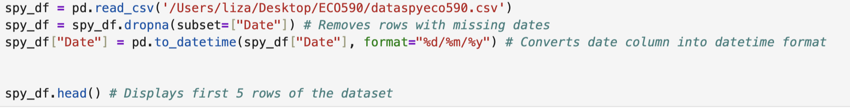
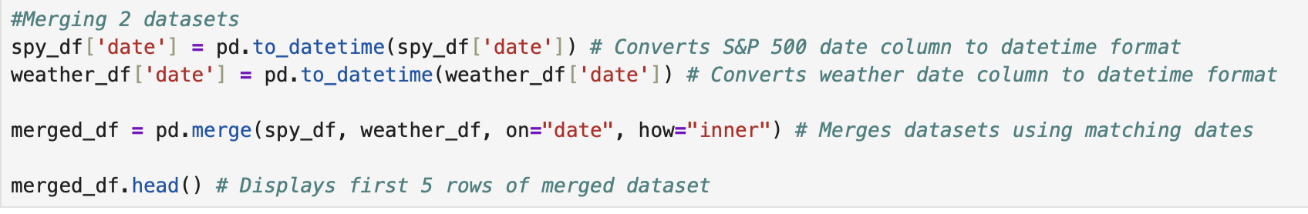
Merging dataframes

Slide 6
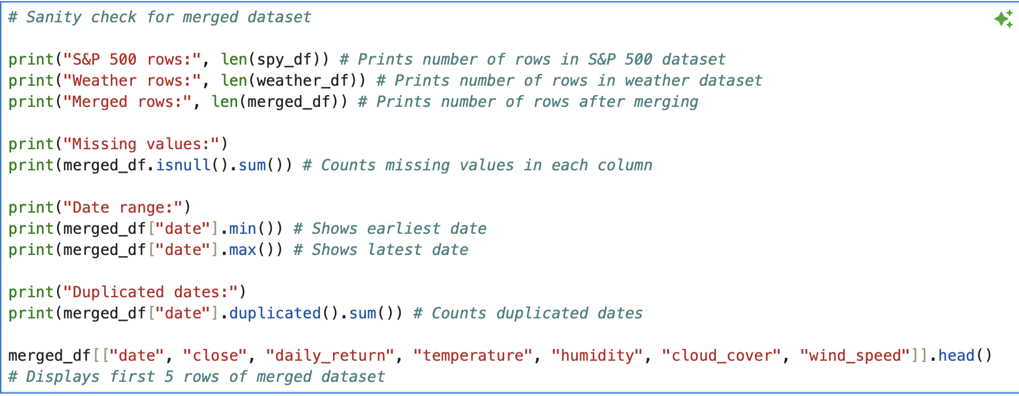
Sanity checks

Slide 7
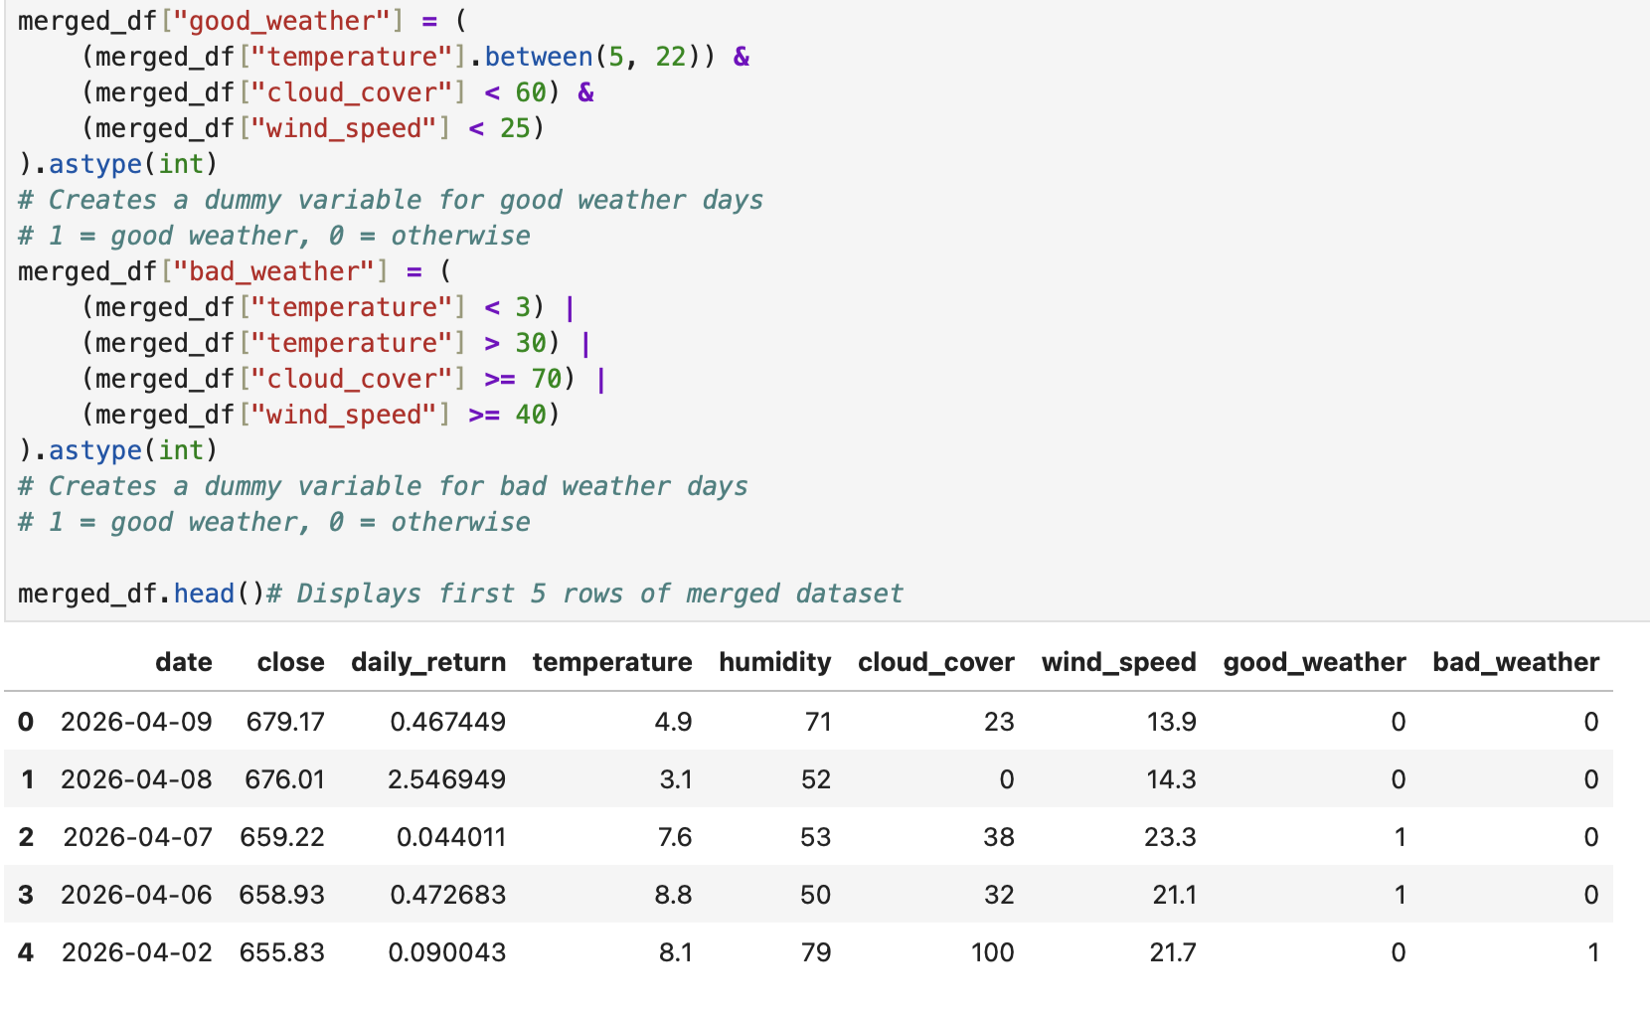
Creating New Variables

Slide 8
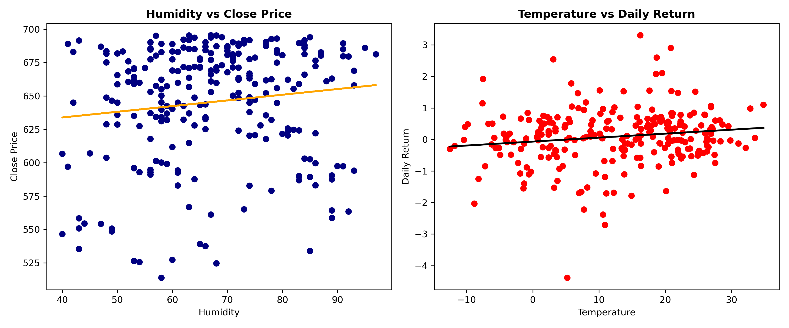
Weather Variables and Market Performance

Slide 9
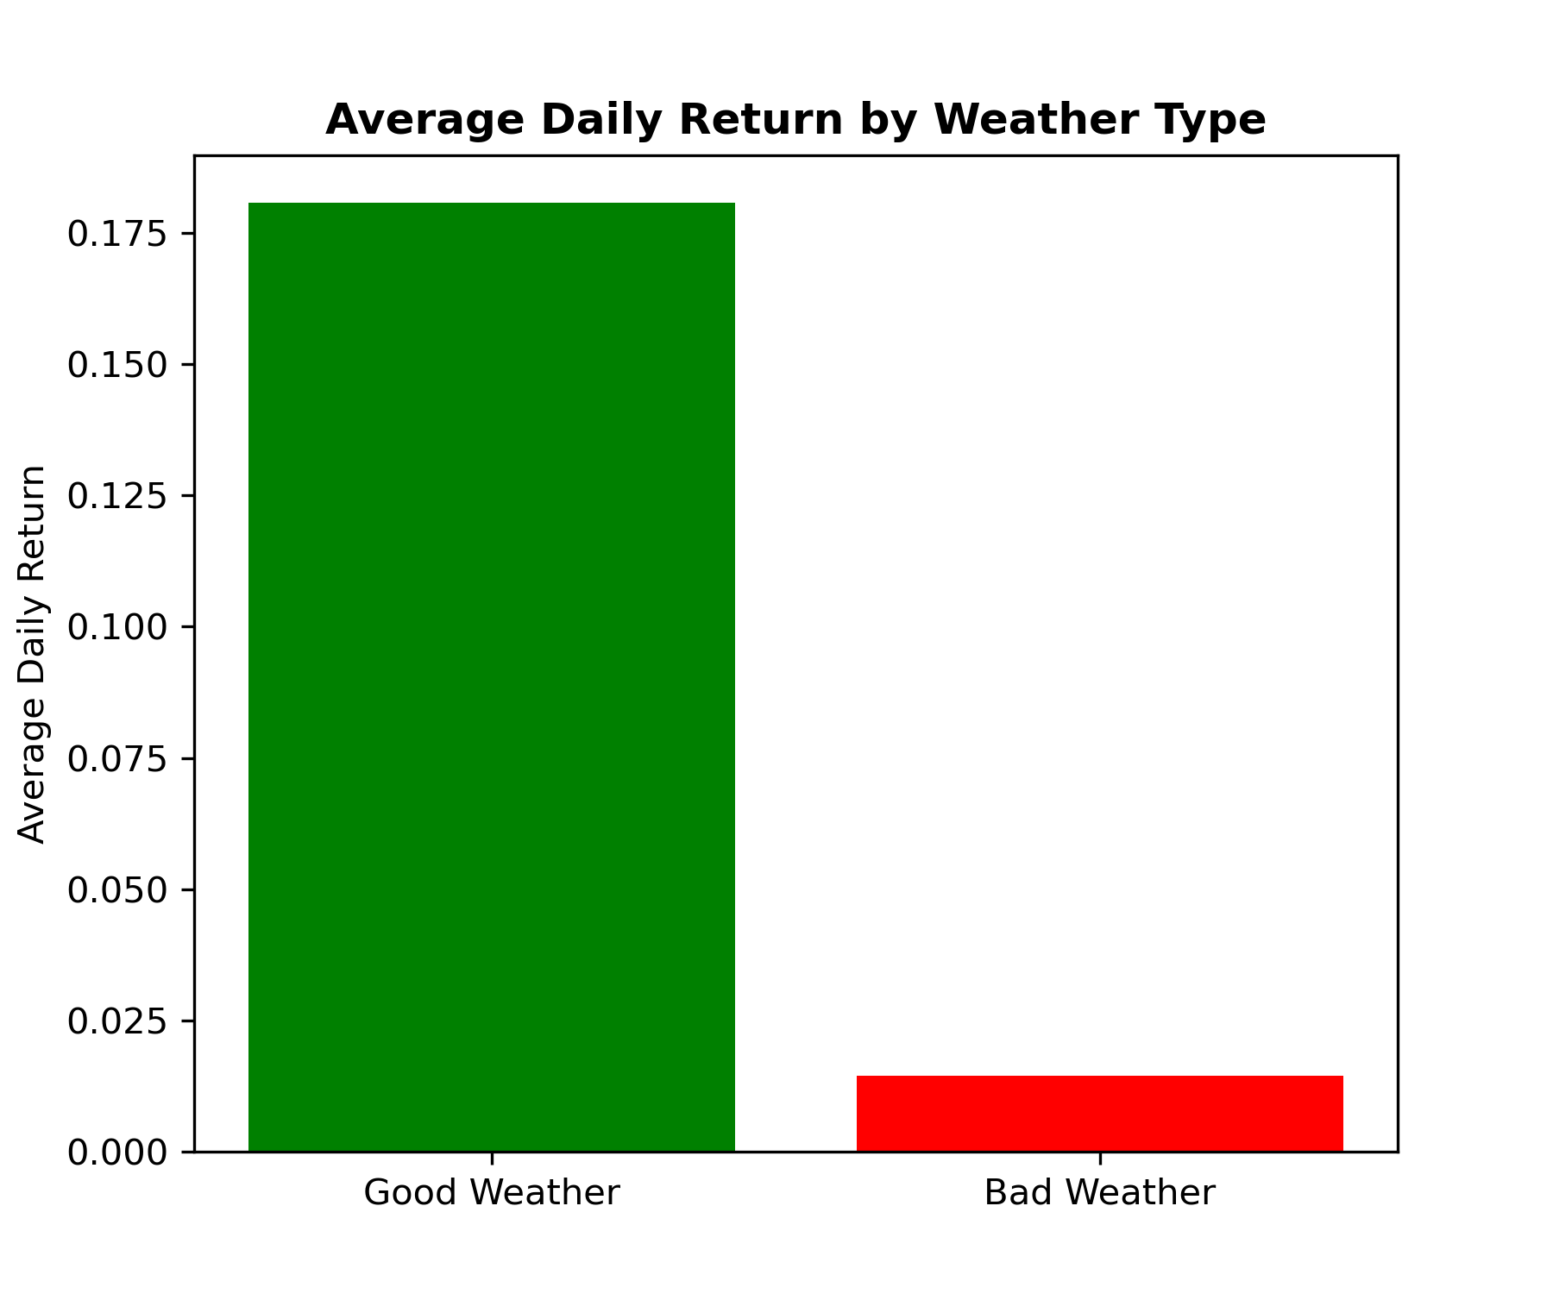

Slide 10
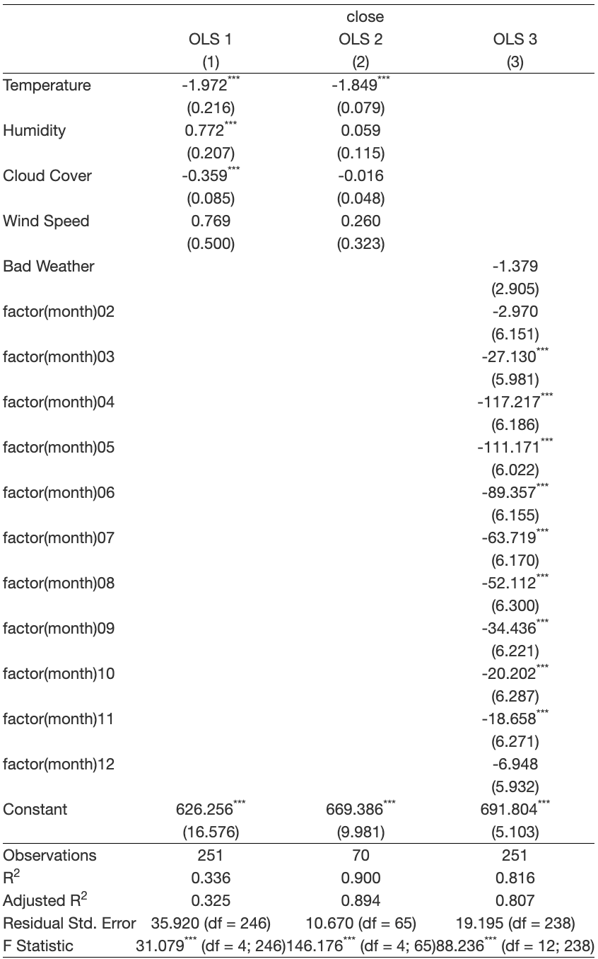
Regression Conclusion
The third regression is the preferred model because it includes the ”bad_weather” variable and monthly controls for seasonality. The results show that bad weather is associated with lower S&P 500 closing prices, but the relationship is not statistically significant. At the same time, many month variables are significant, which suggests that seasonal patterns explain stock market movements better than weather conditions alone.
Overall, the analysis shows that weather may have some influence on investor behavior, but its effect on the market appears limited compared to larger economic and seasonal factors.

Slide 11
Thank you !

